Slide 1

Facial Recognition Using ML
Made By:
Mohamed El-Halwagy
Bavly
Saifullah

Slide 2

01
Libraries and tools used

Slide 3
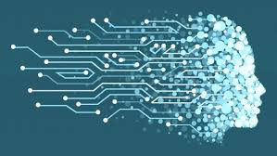
Pandas
Numpy
Matplotlib
OpenCV
Skimage
Scikit-learn

Slide 4
02
Data Processing

Slide 5
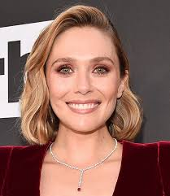
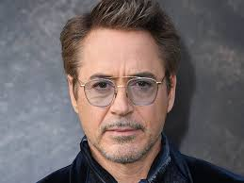
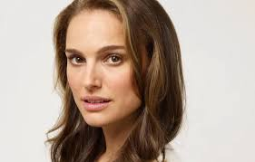
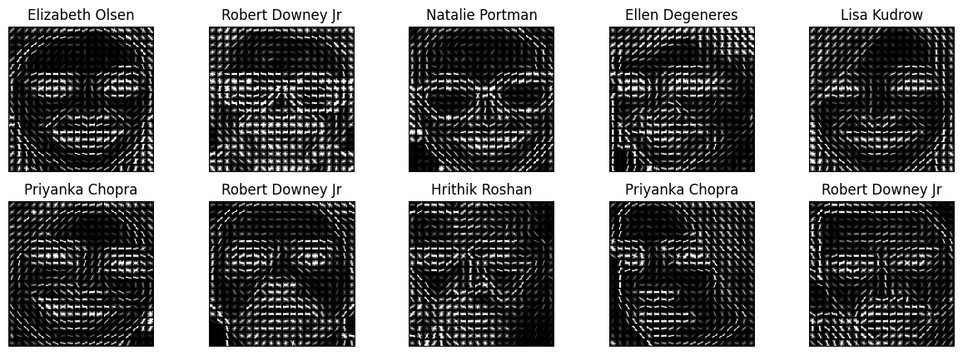

Slide 6
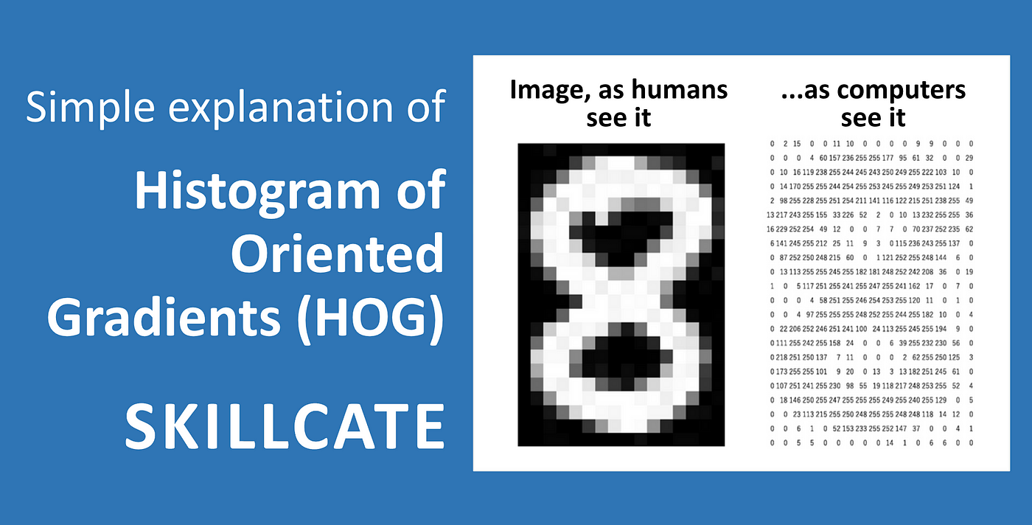
HOG:Finding the Shape of Things
What HOG is:
Emphasize that HOG (Histogram of Oriented Gradients) is a feature descriptor used in computer vision.
Explain that it captures the shape and texture of objects by analyzing gradient orientations.
Why HOG is used:
Highlight its effectiveness in object detection, particularly for tasks like face detection.
Mention its robustness to variations in lighting and small geometric changes.
Why This Works:
It uses relatable concepts like "edges" and "directions."
It focuses on the finding shape rather than the complex calculations.

Slide 7
03
Machine Learning Models

Slide 8
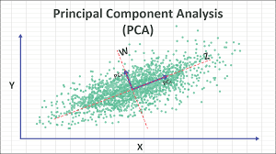
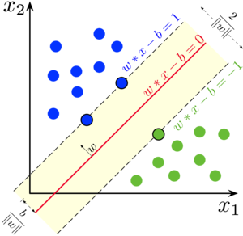
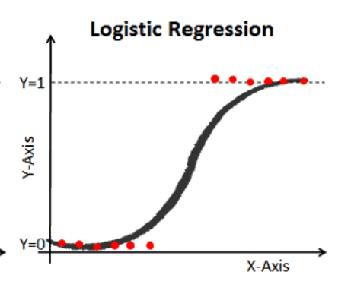
Machine Learning Models Used
Principal Component Analysis (PCA)
Support Vector Machine (SVM)
Logistic Regression
Compare the models based on accuracy and performance

Slide 9
04
Choosing the Best Model

Slide 10
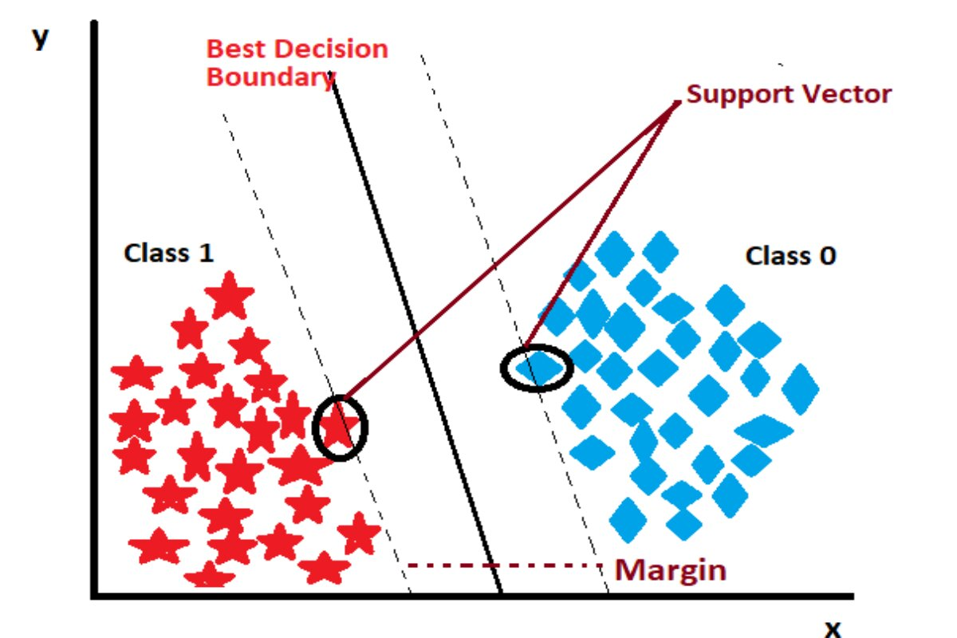
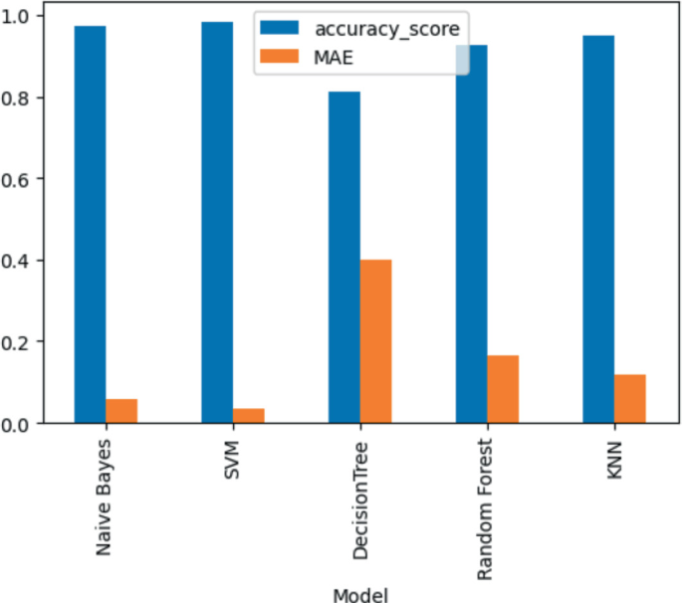
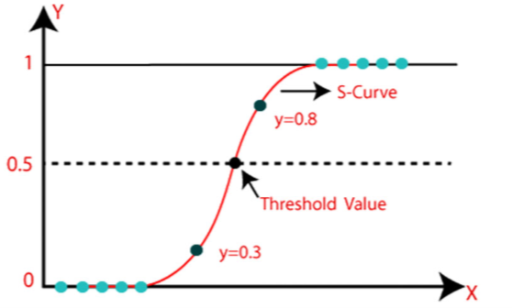
Which Model Should I Use?
Compare Accuracy
Choose Best Model
Evaluate
Performance
Choose the best in terms of accuracy and classification results
Evaluate using performance metrics
A bar chart showing the accuracy of each model

Slide 11
05
Model Training & Evaluation

Slide 12
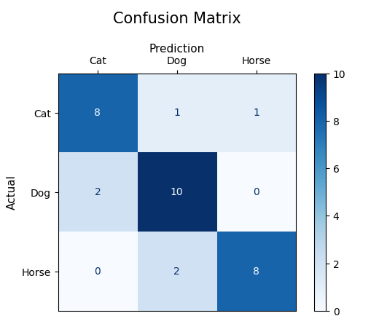
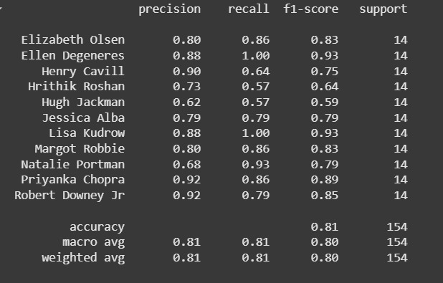
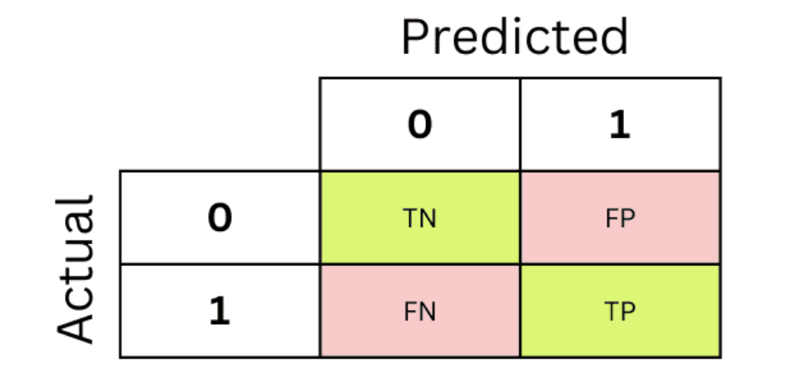
Model Training & Evaluation
Splitting data into training and test sets:
Use an 80/20 split, allocating 80% of the data for training and 20% for testing.
Evaluating performance:
Use accuracy score, confusion matrix, and classification report to evaluate the performance of the model.

Slide 13
06
Results and Visualizations

Slide 14
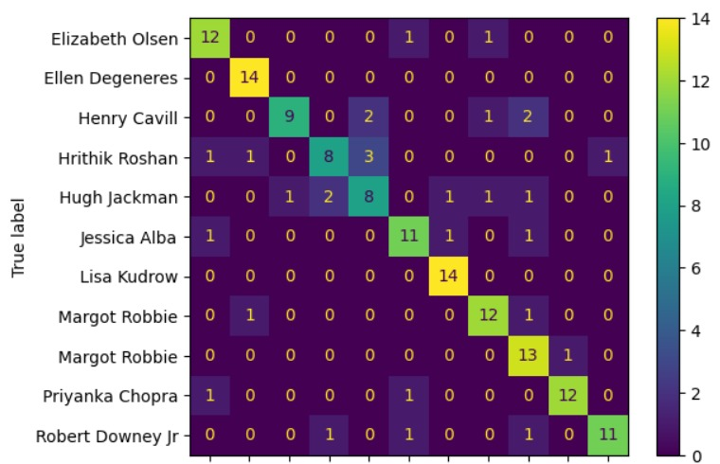
Our Confusion Matrix:
Feature importance and model performance metrics:
SVM showed the highest accuracy compared to other models

Slide 15
Conclusion

Slide 16
Model Training & Evaluation
This project focused on developing an AI-based face classification system using machine learning. We utilized Python libraries like OpenCV and scikit-learn for image processing and model training. The SVM's superior performance was confirmed through rigorous evaluation using metrics like accuracy, confusion matrix, and classification report.

Slide 17
Thanks!
Do you have any questions?

